Slide 1
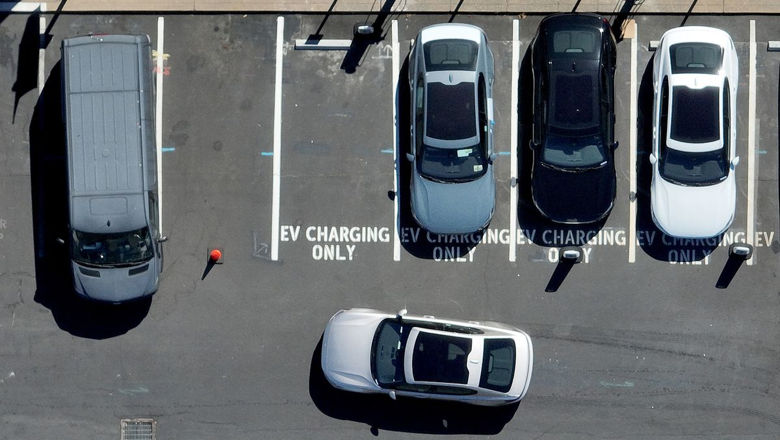
ELECTRIC VEHICLE USE IN NEW SOUTH WALES
Group One
Cayley Morrow Chang Yu
Damian Kifuso
Julian Ravelo

Slide 2
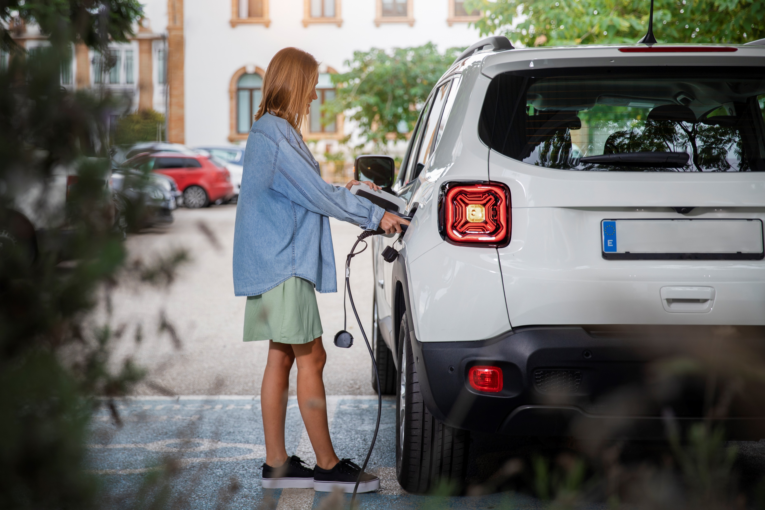
Introduction
Australia is committed to achieving net zero emissions by 2050, prompting an investigation into practical and responsible ways to help reduce emissions. Technology is a key focus in Australia's Long-Term Emissions Reduction Plan, with electric vehicles emerging as a significant component in the conversation around technological solutions.
“Electric cars in Australia are continuing to increase, with the total volumes of sales in the first half of 2023 so far beating the total for 2022. As of the end of June 2023, 46,624 EVs had been sold in Australia – almost 3 times higher than the same period in 2022 (a 269% increase)”

Slide 3

Why NSW?
NSW is the frontrunner in the electric vehicle movement within Australia, boasting the highest number of EV registrations in the country.
NSW has been proactive in its approach to accelerating the adoption of EVs, with the introduction of a $663 million Electric Vehicle Strategy in June 2021 and other incentives.
NWS has the largest number of public electric vehicle (EV) charging locations in Australia, with 174 out of the country's total 558, making up 31%. NSW also has the highest number of EV registrations in the country.

Slide 4
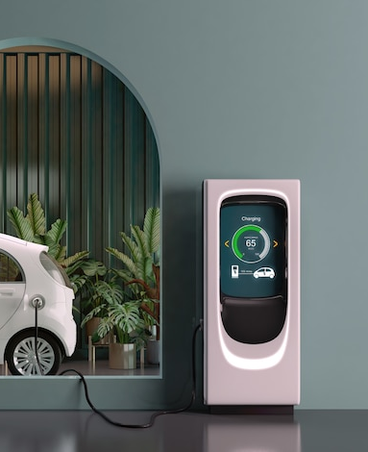
Project Overview
Analyse the influence of electric vehicles (EVs) in New South Wales (NSW) and whether the surge in EV adoption correlates with a change in primary fuel sources used within the state
Create a JavaScript dashboard that enables users to explore and interact with a collection of data through a combination of charts and map visualisations
Provide insightful comparisons between NSW and other key Australian states, namely Queensland, Victoria, South Australia, and Tasmania

Slide 5
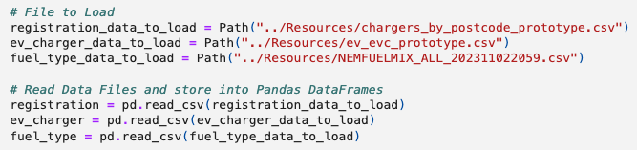
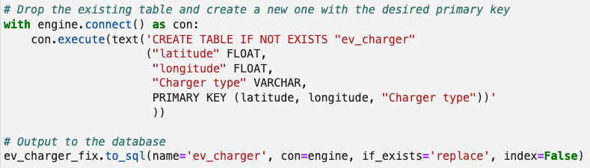
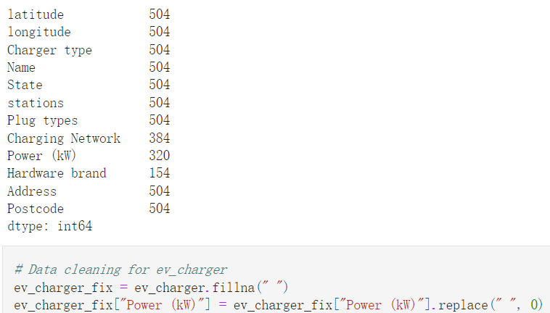
Data Cleaning
Creating a SQL Database
Convert the 3 datasets from CSV files into Pandas DataFrames
Once all CSV files have been cleaned, convert to a SQL Database
Check for any missing values (there should be 504 in each column)
Replace any null values with zero
Notes:
This is showing an example of what was done for one CSV file

Slide 6
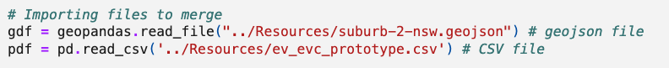
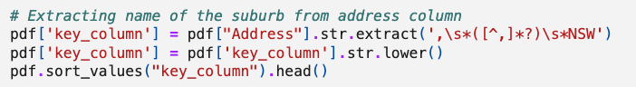
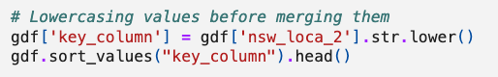
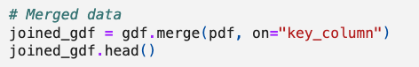
Cleaning the geoJSON
Import the geoJSON and the CSV file that contains EV Charger Details
Clean the CSV to allow for merging with the geoJSON
Merge the data and export as a new geoJSON

Slide 7
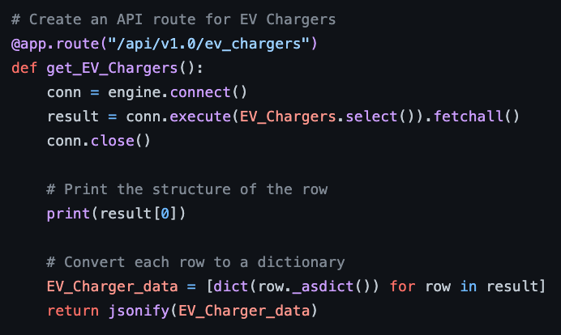
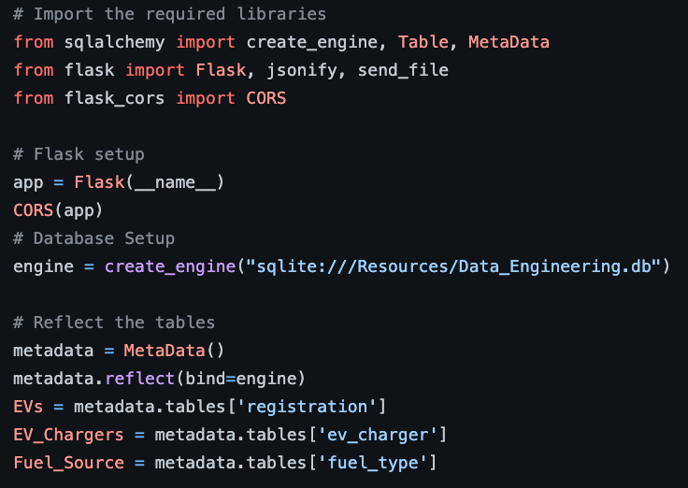

Define an API route that converts the ‘ev_charger’ data in JSON format
Creating a Flask API
Set up Flask and create a connection to the SQL database
Create a reference for the tables in the database
Define an API route that reads the Suburbs GeoJSON
Notes:
Flask_cors (CORS) function allows the frontend user to make requests to the created Flask API without encountering any Cross-Origin Resource Sharing restrictions

Slide 8
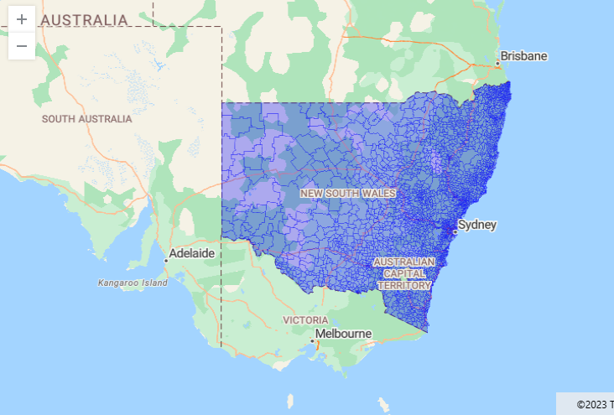
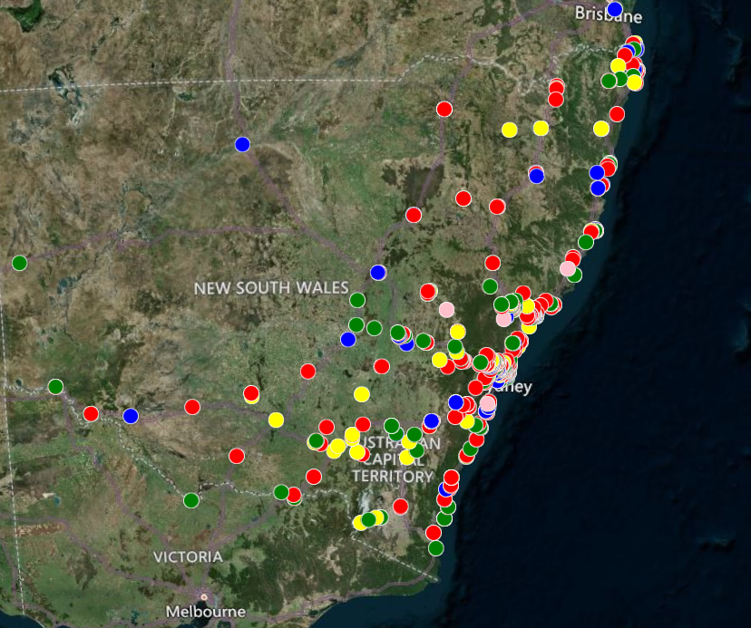
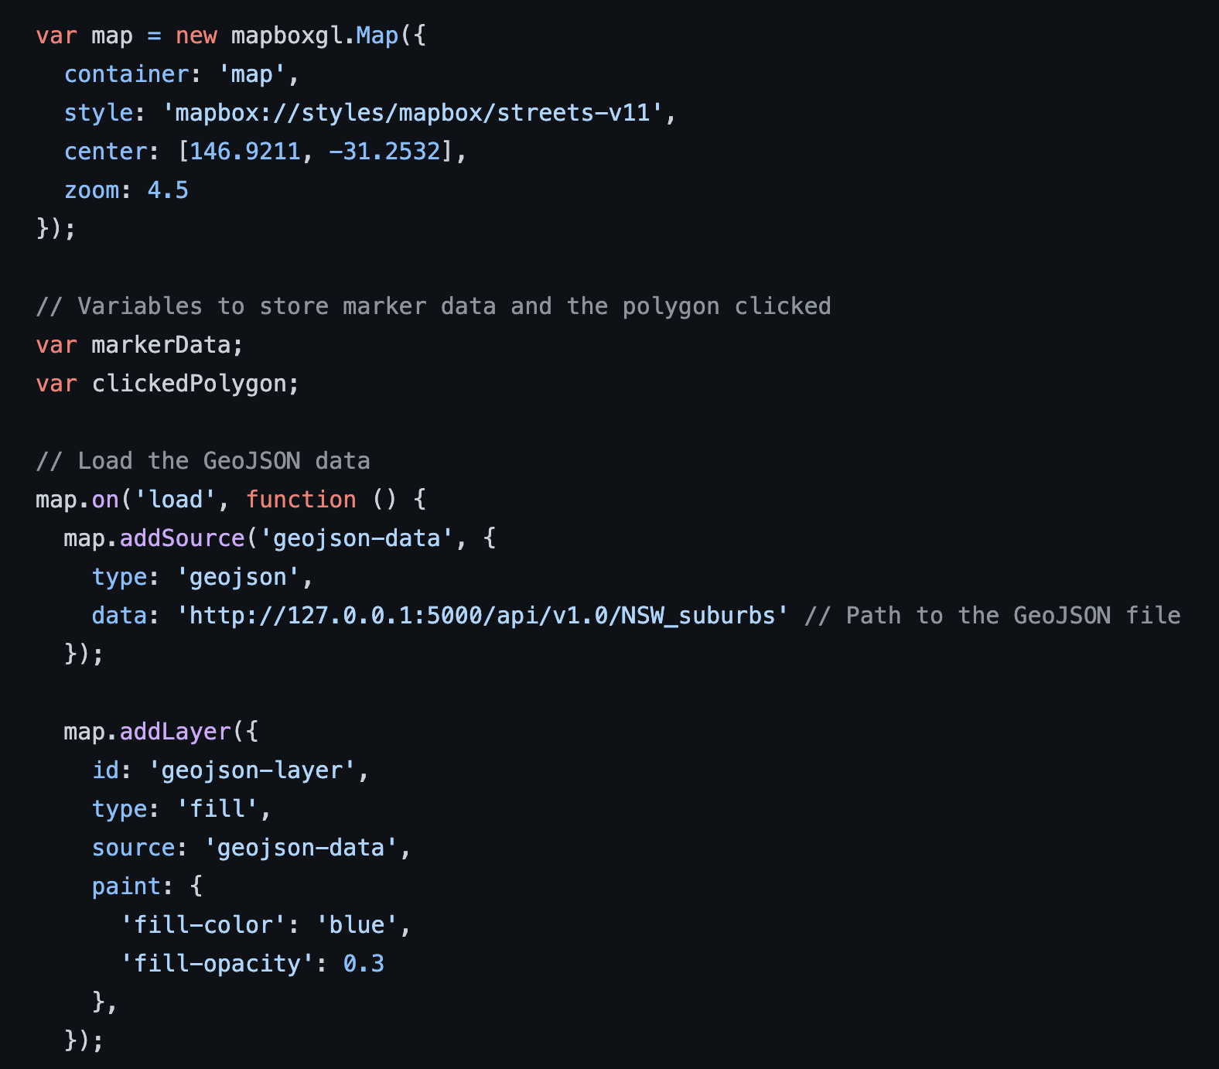
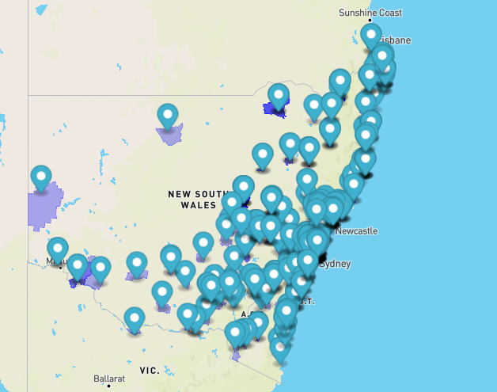
Interactive Map Using Mapbox
Using Mapbox to make an interactive map that highlights suburbs that have at least one EV charger.
Load the map and use the geoJSON to create the polygons displaying the suburbs

Slide 9
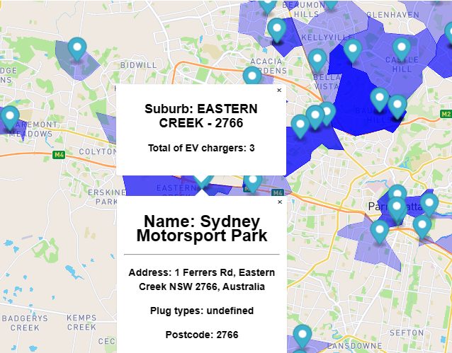
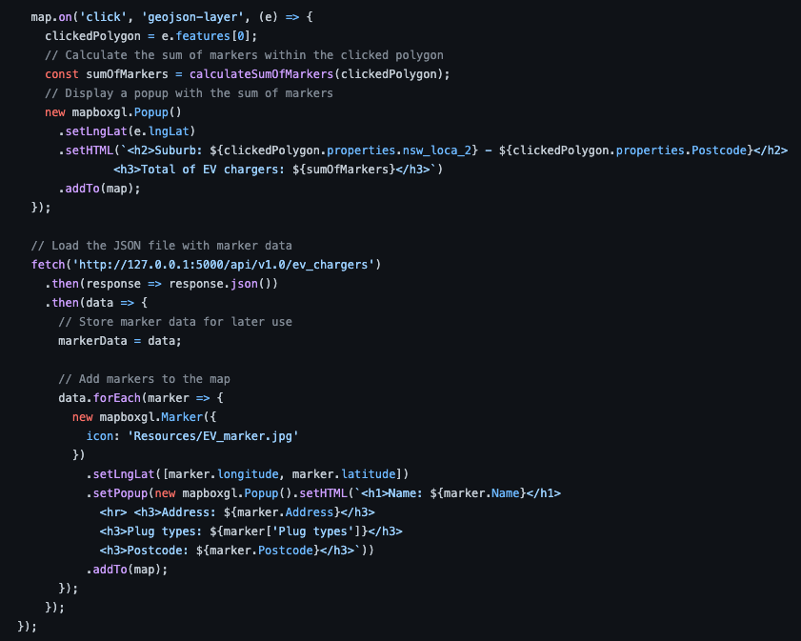
Interactive Map Using Mapbox
Using Mapbox to make an interactive map that creates markers with charger location and details.
Create a pop up when the user clicks on a suburb or a charger marker and display information

Slide 10

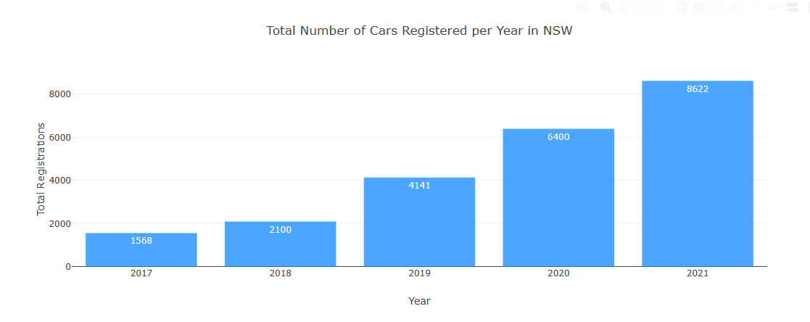
Bar Chart
Using plotly to create a bar chart to display the number of Electrical Vehicles registered in NSW between 2017 and 2021.

Slide 11
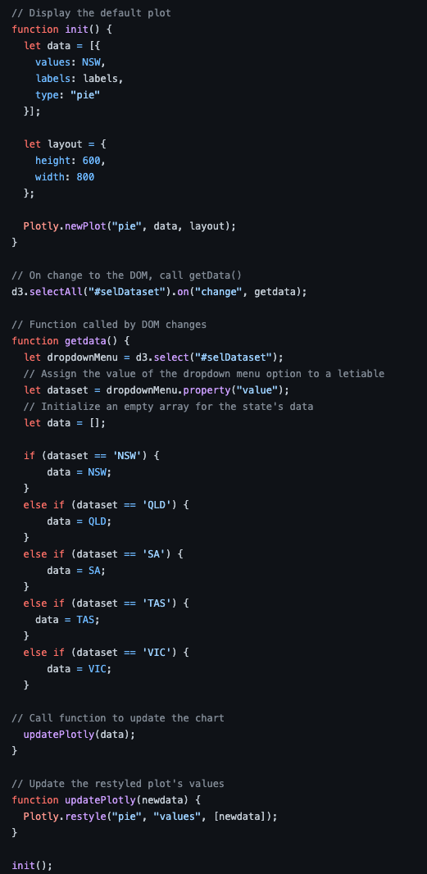
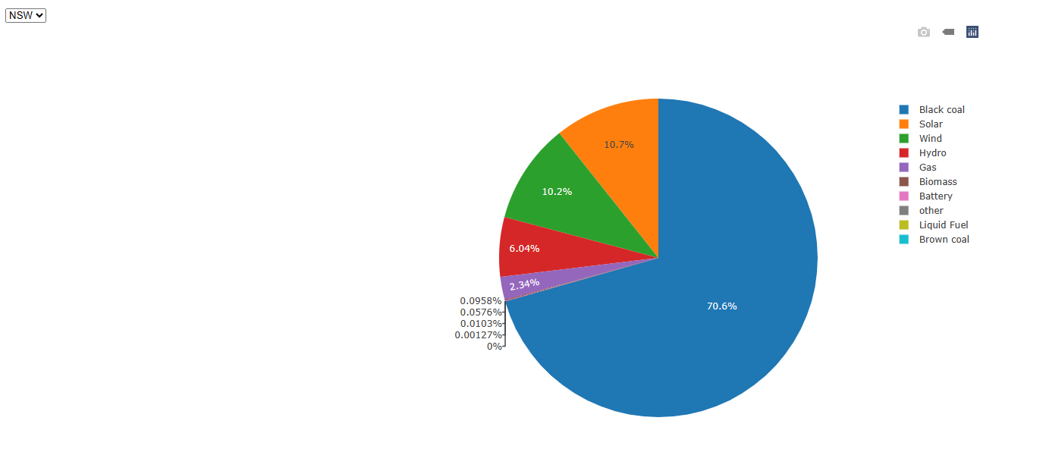
Interactive Pie Chart
Source of Electricity
Using plotly to create an interactive pie chart to display the fuel
breakdown for the states that use the National Energy Market.
By selecting the dropdown menu users can check the data per state

Slide 12
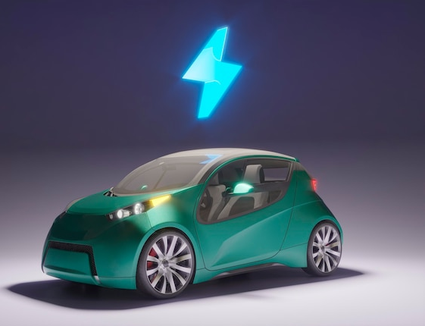
Limitations
The data obtained from the Australian Government NationalMap around Electric Vehicle registrations was only for NSW and between the years 2017 – 2021. No recent data was available.
We were unable to display Western Australia and Northern Territory in our Source of Electricity display due to these states not being part of the National Electricity Market
All other data used was based on recent records (2023).
Main Sources Used in the Project
01
02
03
04
Electric Vehicle Council – State of Electric Vehicle July 2023
Australian Government – National Electric Vehicle Strategy 2023
Australian Government NationalMap – Energy – Electric Vehicle Data
Australian Energy Market Operator – National Electricity Market Fuel Mix Dashboard

Slide 13
Demonstration

Slide 14
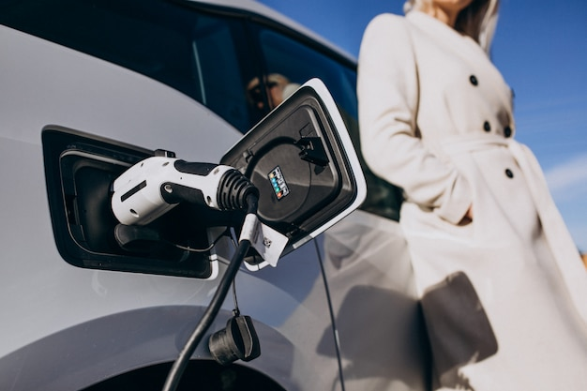
Conclusions
Although NSW is the leading state in EV uptake from the data shown it does not directly correlate to a decrease in fossil fuels used (such as black coal) as an electricity fuel source. In relation to QLD and VIC fuel source for electricity, it is not much different percentage wise for NSW despite the impressive efforts made on the EV front
EVs introduction as the mainstream is part of a very large list of efforts need to be made by the country

Slide 15
Thank you for listening to our presentation

